Slide 1
Academic Writing

Slide 2
Written academic English is objective
The language of academic writing is objective. It is used as a vehicle for logical argumentation, not self-expression or emotional response. Objective language is measured, fair and accurate. It avoids exaggeration and bias, and shows respect for the views of others.

Slide 3
Written Academic English is Cautious
It is important that the language used in academic writing reflects the strength of evidence available to support an idea or claim.
Whether you say
“The working-age population will fall”, “
The working-age population will probably fall” or
“The working-age population may fall”
will depend on the projections available to you at the time of writing, and your interpretation of those projections. The less certain you are about your claims, the more tentative the language should be. The use of cautious language in academic writing is known as ‘hedging’.

Slide 4
Hedging
When writing, be careful of using words such as 'definitely' or 'proves'. Ask yourself whether your statement is a fact or whether there may be some doubt either now or in the future.
Some useful hedging words and phrases to use in your work are:
This suggests....
It is possible that...
A possible explanation...
Usually...
Sometimes...
Somewhat...

Slide 5
Hedging
Read the following two sentences:
Research proves that drinking a large volume of fizzy drinks containing sugar leads to the development of type II diabetes.
Research suggests that high consumption of fizzy drinks containing sugar may contribute to the development of type II diabetes.

Slide 6
Boosters
You might want to express a measure of certainty or conviction in your writing and this is when 'booster' language can help.
Some useful booster words and phrases to use in your work are:
Clearly (only use if you are certain it is clear)
There is a strong correlation...
Results indicate...

Slide 7
Research suggests that high consumption of fizzy drinks containing sugar may contribute to the development of type II diabetes.
Research indicates a clear link between the high consumption of a large volume of fizzy drinks containing sugar and the development of type II diabetes.
In sentence 1, the writer has used the hedging language 'suggested' and 'may contribute', to show that while there is evidence to link sugary drinks and type II diabetes, this may not be true for every person and may be proven to be incorrect in the future.
In sentence 2, the writer still uses language to allow for doubt and argument but it is clear that this writer is more convinced by the research.

Slide 8
Written Academic English is formal
Formal language is more precise and stable, and therefore more suitable for the expression of complex ideas and the development of reasoned argumentation.

Slide 9
Written Academic English is formal
In academic writing you are expected to use formal language as opposed to colloquial or informal language:
Avoid using colloquialisms or slang terms such as 'sort of' or 'basically'. Instead you could use 'somewhat' or 'fundamentally'
Write words out in full rather than contracting (or shortening) them. For example, instead of writing 'don't' or' isn't' you would be expected to write 'do not' or 'is not'
The use of clichés is not appropriate in academic writing. These are phrases such as 'at the end of the day' or 'in the nick of time.' Instead of this you might write finally or at the critical moment

Slide 10
Choice of words
Some words are more appropriate in informal situations, while others are used in formal or neutral contexts. In academic writing, the formal or neutral alternative is normally preferred.
The following advice will help you to make appropriate vocabulary choices:

Slide 11
Avoid phrasal verbs and idioms
Example 1
Colloquial/idiom: Her paper made tremendous contribution to the field.
Formal/neutral: Her paper made a major contribution to the field.
Example 2
Colloquial/idiom: The community managed to scratch a living from the poor soil.
Formal/neutral: The community managed to survive by farming the poor soil.
Example 3
Colloquial/idiom: The hit-and-miss performance of the financial markets is causing increasing concern.
Formal/neutral: The erratic performance of the financial markets is causing increasing concern.

Slide 12
Avoid phrasal verbs and idioms
Example 4
Colloquial/idiom: The proposal for regional representation was turned down.
Formal/neutral: The proposal for regional representation was rejected.
Example 5
Colloquial/idiom: Scientists are looking into the production of biofuels using non-food crops.
Formal/neutral: Scientists are investigating the production of biofuels using non-food crops.
Example 6
Colloquial/idiom: Biofuels based on non-grain crops have the potential to bring food prices down.
Formal/neutral: Biofuels based on non-grain crops have the potential to reduce food prices.
Example 7
Colloquial/idiom: Most of the patients reported that they put on weight after taking the new medication.
Formal/neutral: Most of the patients reported that they gained weight after taking the new medication.

Slide 13
Avoid using the verb ‘get’
Example 1
Colloquial/idiom: The settlers got ill after drinking polluted water.
Formal/neutral: The settlers became ill after drinking polluted water.
Example 2
Colloquial/idiom: The study participants reported that they got better after the first course of treatment.
Formal/neutral: The study participants reported that their health improved after the first course of treatment.
Example 3
Colloquial/idiom: Malala Yousafzai got the Nobel Peace Prize .
Formal/neutral: Malala Yousafzai was awarded the Nobel Peace Prize .

Slide 14
Use nominalizations
Nominalizations are useful in academic writing because they convey an objective, impersonal tone. Nominalizations can also make the text more concise because they can pack a great deal of information in a few words.

Slide 15
Use nominalizations
Compare these two sentences:
The government banned smoking in public places in 2007. Since then, fewer people have been admitted to hospital for smoking-related diseases.
The ban on smoking in public places in 2007 has led to a fall in hospital admissions for smoking-related diseases.
In the sentence above, 'the ban on smoking in public places in 2007' is a nominalization of the verb phrase 'banned smoking in public places in 2007';
'a fall in hospital admissions for smoking-related diseases' is a nominalization of
'fewer people have been admitted to hospital for smoking-related diseases'.

Slide 16
Use pre- and post-modifiers
In the sentence below, the nouns in bold, 'decline' and 'rise', have both pre- and post-modification. Modification is indicated by underlining:
The unexpected decline in species that had previously thrived in the area was attributed to a sharp rise in temperature.
Pre-and post-modification enables the writer to pack a lot of information into a limited number of words, thus making the style more concise.

Slide 17
Avoid the ‘not + verb’ negative form if an alternative form is available
‘Not + verb’ negative
There isn’t any evidence in support of this claim.
The new study doesn’t support many of the initial findings.
There isn’t much research on this topic.
Preferred negative form
There is no evidence in support of this claim.
The new study supports few of the initial findings.
There is little research on this topic.

Slide 18
If you use the ‘not + verb’ negative form, avoid contracted forms.
‘Verb + not’ contracted form
Sales didn’t increase despite the introduction of new targets.
The conflict can’t be resolved without negotiation.
Preferred negative form
Sales did not increase despite the introduction of new targets.
The conflict cannot be resolved without negotiation.

Slide 19
Be concise
In formal academic writing it is important to be concise. This helps your reader to understand the points you are making. Here are some tips to help you
Only include one main idea per sentence
Keep your sentences to a reasonable length (generally not more than 25 words). Long sentences can be difficult to follow and this may distract from your point
Avoid repetition
Avoid using redundant words.

Slide 20
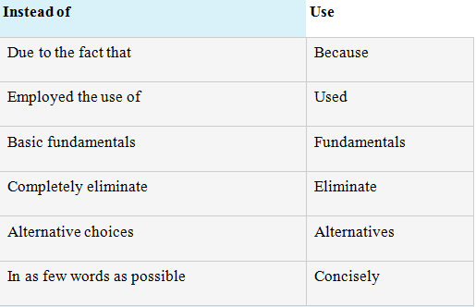
Be concise

Slide 21
Active and Passive Voice
Example 1
Active: The nurse administered the injection.
Passive: The injection was administered by the nurse.
Example 2
Active: We kept the honey bees in a humidified chamber at room temperature overnight.
Passive: The honey bees were kept in a humidified chamber at room temperature overnight.
Active: We heated the solution to 90°C for approximately 30 minutes and then allowed it to cool.
Passive: The solution was heated to 90°C for approximately 30 minutes and then allowed to cool.

Slide 22
Active and Passive Voice
Just as varying the sentence length in your scientific manuscript creates more variety and interest for your readers, so, too, does using both active and passive voice.
Choose the active voice whenever possible. (Example 1)
Choose the passive voice if you have a good reason to do so. Consider passive voice when: (Example 2)
The performer is unknown, irrelevant, or obvious.
The performer is less important than the action.
The recipient is the main topic.

Slide 23
Use signaling words and phrases to show the structure of your writing
Signaling words can be used to explicitly demonstrate the relationship between ideas and arguments.
These words help to make the structure of the writing more effective; they can clarify the flow and logic of the argument and make it easier for the reader to understand the points being made.
They are called signaling words because they give the reader a clue as to what might be coming up next or where the argument might be going.

Slide 24
Have a look at these examples below:
Using a laboratory method was beneficial as a causal relationship could be established between cognitive load and generating attributes. However, this method creates an artificial setting which reduces the study's ecological validity. In this example the use of the word however at the beginning of the second sentence indicates that a contrasting point of view is about to be made. It also suggests that the writer may have more sympathy with the second opinion.

Slide 25
Firstly, the concepts and person centred care will be defined.... Next, communication will be discussed... Finally, the relationship between loss and communication will be examined. [Taken from a Healthcare essay] In this example the writer has used signalling words to demonstrate the sequence of their argument by using Firstly, next, finally making the structure of the essay very clear.

Slide 26
Employee satisfaction is justifiable to employees because it causes an improvement on their well being (Grandley, 2003). Moreover, employees that are in a good mood at work are less likely to act because their true feelings are in accordance with the needed display of emotions (Grandley, 2003). [Taken from a Business School essay] The use of the word moreover tells the reader that the next sentence will provide further evidence or information to support the statement made in the first sentence. It also suggest that the writer strongly agrees with the first statement.

Slide 27
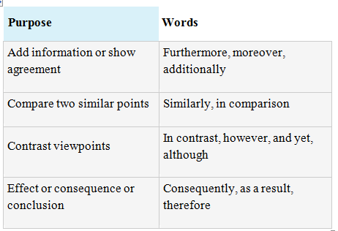
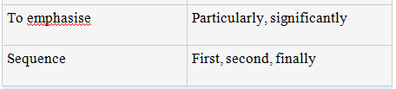
Examples of signaling words

Slide 28
Use the correct tense
You will probably need to use different tenses throughout depending upon the context but here are some general guidelines to help you if you are unsure:
If you are writing about established knowledge then use the present tense.
For example, "Diabetes is a condition where the amount of glucose in the blood is too high because the body cannot use it properly." (Diabetes UK, 2015)

Slide 29
If you are writing about an experiment you carried out or a method you used then use the past tense. "Our experiment showed wide variations in results where the variable was altered even slightly."
When you are reporting on the findings or research of others then you should use the present tense. This is because you are writing about something that is established knowledge.
For example, you might write "Smith's research from 2012 finds that regular exercise may contribute to good cardiovascular health."

Slide 30
When you are writing about your conclusions or what you have found then use the present tense.
For example: "In this case there is not a large difference between the two diameter values (from Feret's diameter and calculated equation), which again is probably due to the fact that the average circularity ratio is on the high end of the scale, 0.88, and therefore infers near circular pores."
If you are writing about figures that you have presented in a table or chart then use the present tense.
For example: "These figures show that the number of birds visiting the hide increase every year in May...".

